Slide 1
Bank Customer churn prediction
By
Divya Achchalakar

Slide 2
Agenda
Problem Statement
Flow of the Project
Data Collection
Preprocessing
First Data Frame
Class Imbalance
Outliers
Second Data Frame
Feature Selection
Third Data Frame
Demerits

Slide 3
Problem Statement
Predicting Customer churn in the banking Industry. It contains information on bank customers who either left the bank or continue to be a customer.

Slide 4
Flow of the Project
Data Collection
Data Processing
Data Frame1
Class Imbalance
EDA
Data Frame 2
Feature Selection
Data Frame 3

Slide 5
Data collection
In Dataset there are 10000 rows and 12 columns.
Target column is Categorical so I used Classification Method.

Slide 6
Preprocessing
Missing value treatment
Data-type conversion
Duplicate checking

Slide 7
Model Building
Data Frame1
Model Name | Accuracy | TPR | FPR | F1_score
LG | 79.00 | 0.97 | 0.94 | 0.88
DT | 77.75 | 0.86 | 0.55 | 0.85
RF | 85.45 | 0.96 | 0.57 | 0.91
KNN | 79.35 | 0.99 | 1.0 | 0.88
NB | 56.50 | 0.56 | 0.42 | 2.00
SVM | 79.40 | 1.0 | 1.0 | 0.88
Ada Boost | 85.70 | 0.96 | 0.59 | 0.91
Xg Boost | 84.80 | 84.0 | 0.53 | 1.72
In Data frame 1 , Random Forest have the high Accuracy compare to other model so Random Forest is best fitted model.

Slide 8
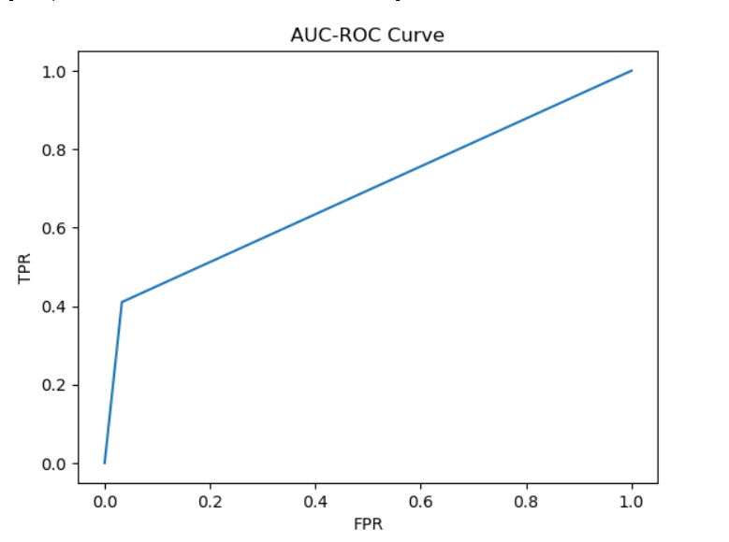
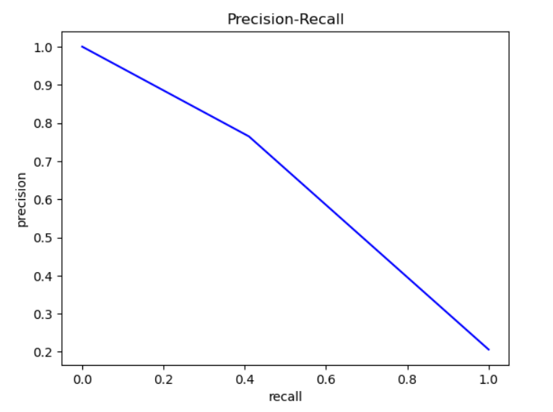
Precision-Recall curve of Random Forest
AUC-ROC Curve

Slide 9
Class Imbalance
7963
7963
Random Oversampling
Before Class Imbalance
churn
0 - 7963
1 - 2037
After Class Imbalance
churn
0 - 7963
1 - 7963

Slide 10
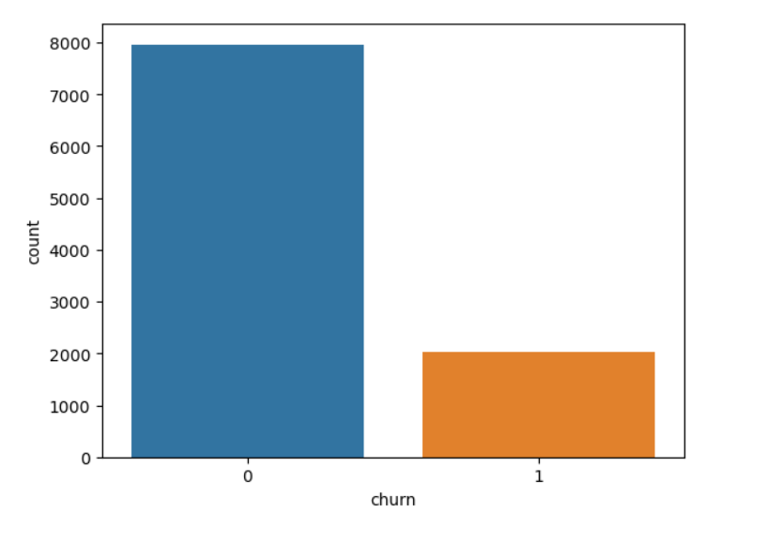
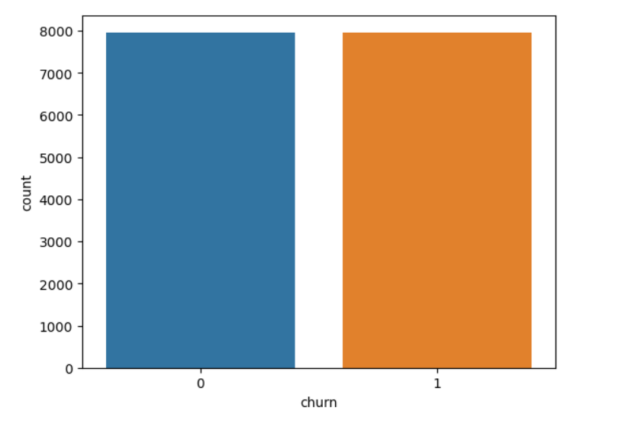
The target variable
Before Class Imbalance
After Class Imbalance

Slide 11
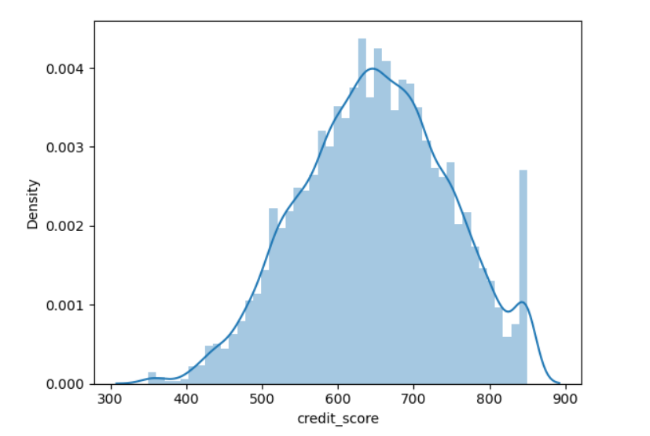
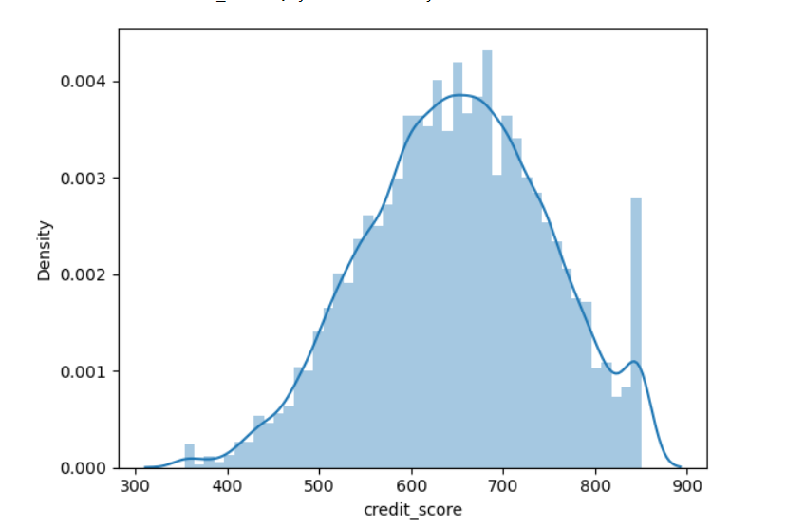
Exploratory Data Analysis Outlier Treatment
From the above distplot we can infer that –
There is a outlier in credit_score and we treated that column

Slide 12
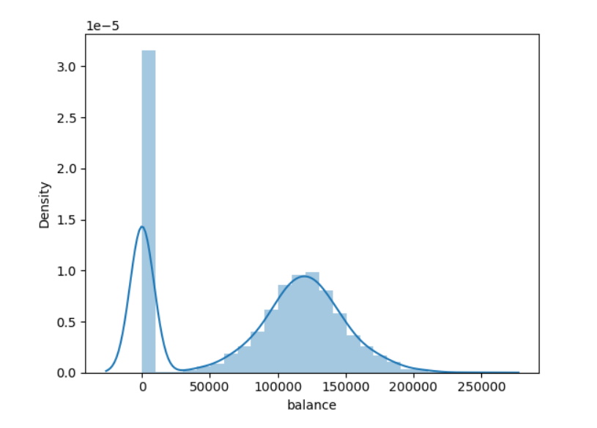
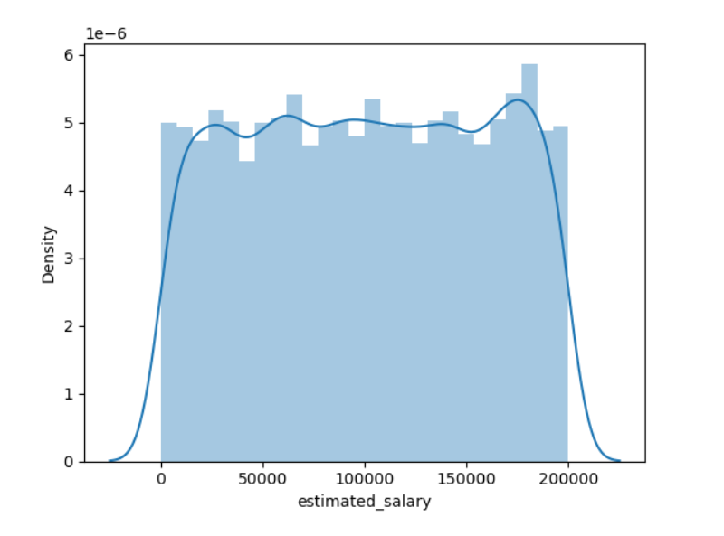
Skewness
There is no skewness
balance
estimate_salary

Slide 13
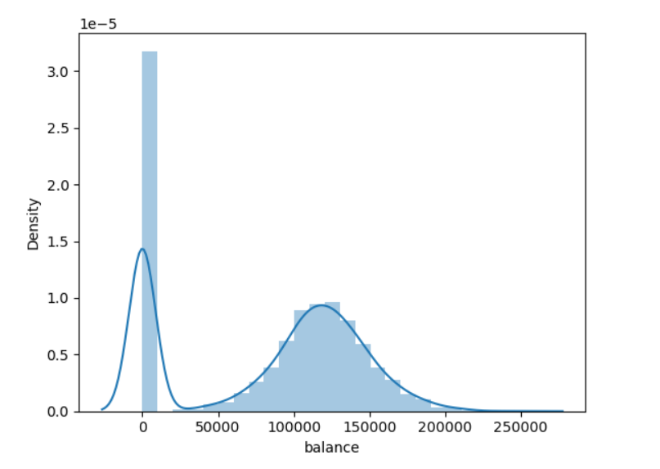
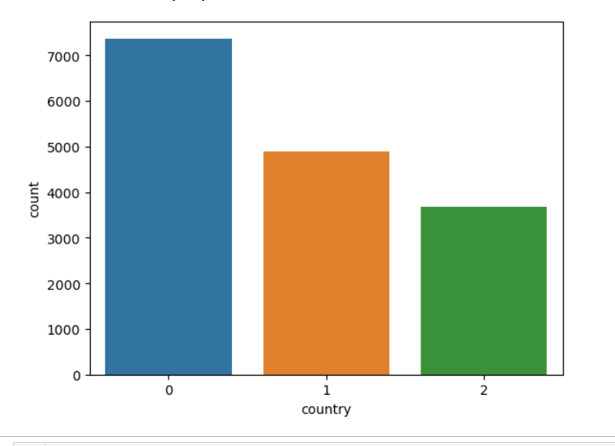
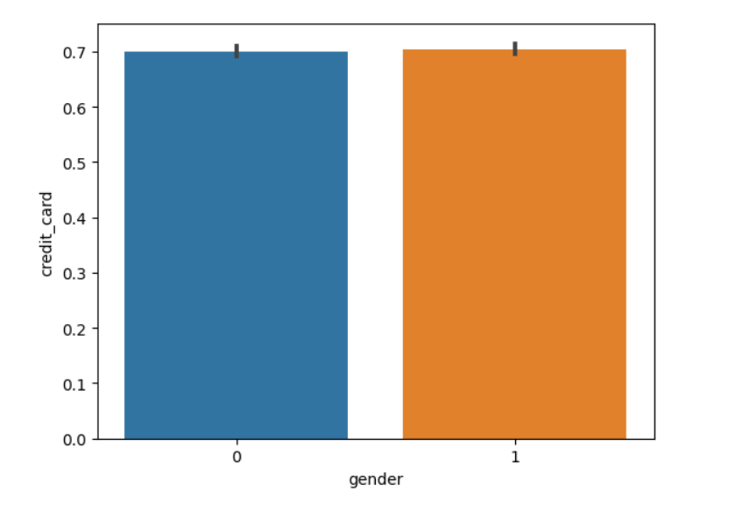
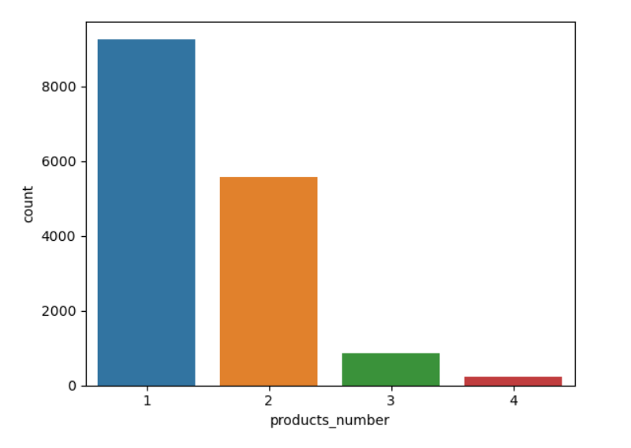
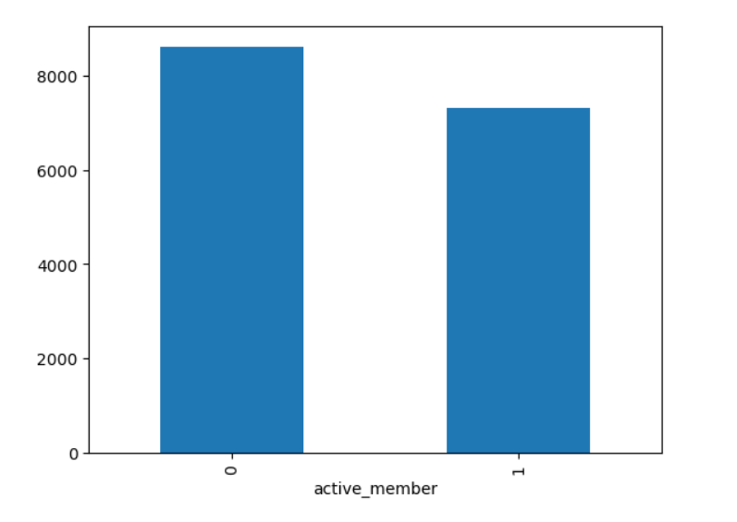
Visualization

Slide 14
Data Frame2
Model Name | Accuracy | TPR | FPR | F1_score
LG | 67.41 | 0.64 | 0.32 | 0.65
DT | 91.61 | 0.86 | 0.022 | 0.91
RF | 95.66 | 0.92 | 0.02 | 0.95
KNN | 60.95 | 0.57 | 0.34 | 0.59
NB | 55.24 | 0.55 | 0.46 | 0.54
SVM | 56.71 | 0.38 | 0.23 | 0.47
AdaBoost | 95.35 | 0.98 | 0.02 | 0.95
XgBoost | 90.55 | 0.87 | 0.06 | 0.90
In data frame 2 Random Forest is the best fitted model.

Slide 15
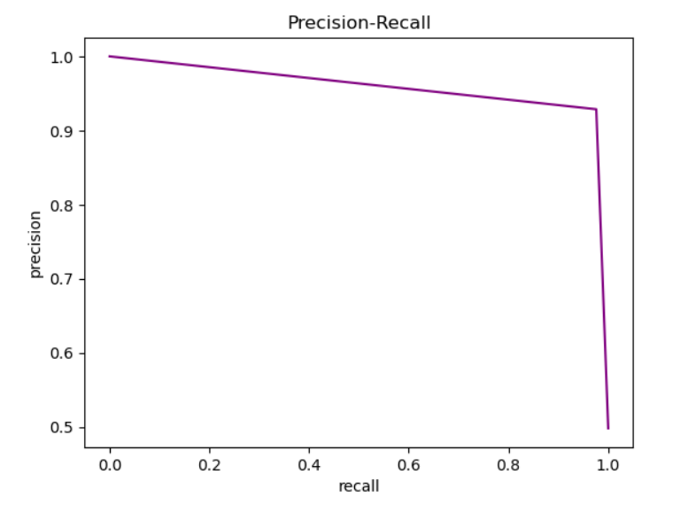
Precision-Recall curve of Random Forest

Slide 16
Feature Engineering
Recursive Feature Elimination

Slide 17
Data Frame3
Model Name | Accuracy | TPR | FPR | F1_score
LG | 66.76 | 0.64 | 0.32 | 0.65
DT | 90.58 | 0.85 | 0.03 | 0.90
RF | 94.25 | 0.90 | 0.02 | 0.93
KNN | 62.74 | 0.64 | 0.32 | 0.65
NB | 55.30 | 0.58 | 0.30 | 0.62
SVM | 56.74 | 0.55 | 0.47 | 0.55
Ada Boost | 90.83 | 0.38 | 0.23 | 0.47
Xg Boost | 87.97 | 0.86 | 0.03 | 0.91
In Data Frame 3 Random Forest have the high Accuracy, High TPR and low FPR and
f1_score is good. So Random Forest is the best fitted model.

Slide 18
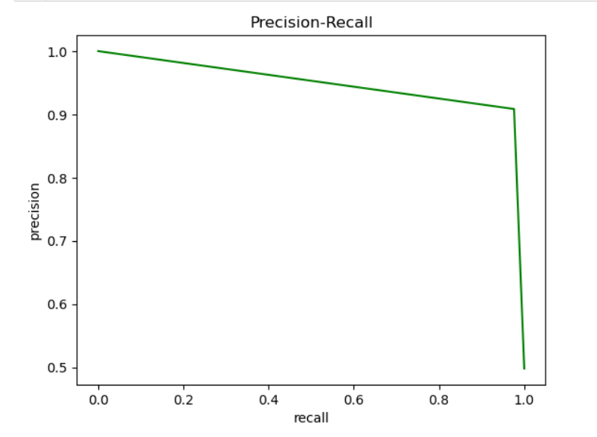
Precision-Recall curve of Random Forest

Slide 19
Merits
If bank do this in time , they can decrease churn rate and increase retention rate
The higher your customer churn rate, the lower your chances of growing your business. Your marketing campaigns may be top-notch, but losing customers at a high rate can still hurt your profits. Acquiring new customers is expensive, so retaining the ones you have is essential
Demerits

Slide 20
Thank you

